Slide 1
New Barbershop in toronto
Coursera IBM Data Science Certification
The Battle of Neighborhoods
Oct 01, 2019
By Elias abou charanek

Slide 2
PROBLEM
A new comer to Toronto wants to open a new barbershop, preferably in a populated postal code, with no or little competition. For this reason, the new investor is only interested in checking a score that reflects the ratio of population to competitor per postal code, to identify the top 5 postal codes to consider.

Slide 3
Technical work
Load the required libraries
Data Acquisition
Population per postal code
Coordinates of postal Code
Foursquare businesses
Data Cleaning and Aggregation
Data manipulation
Results Display

Slide 4
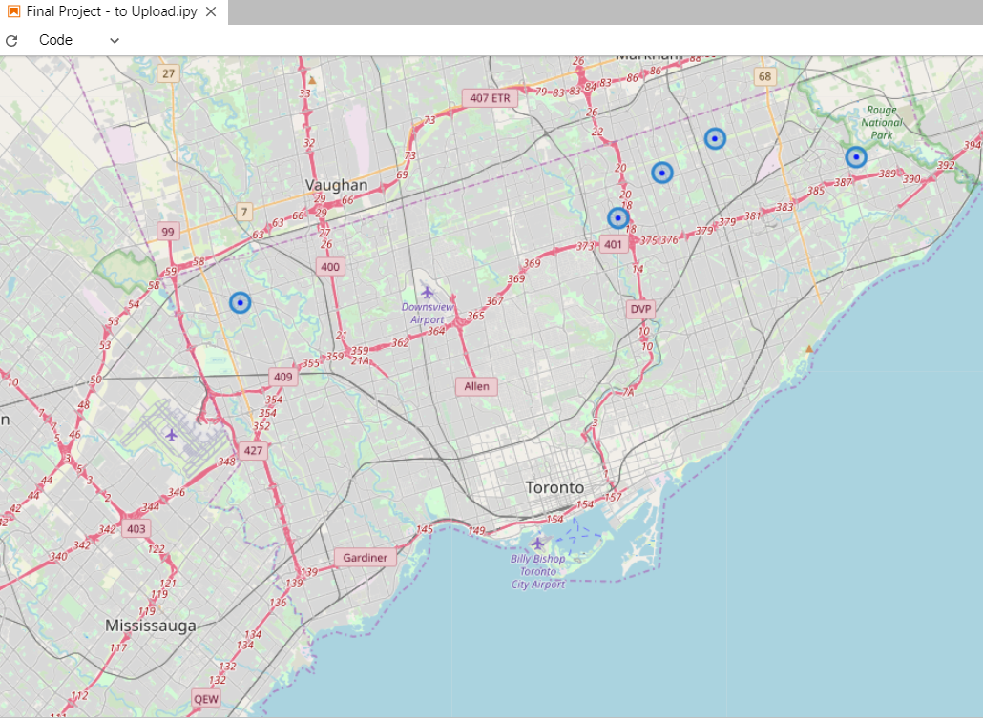
findings
Top 5 show highly populated postal codes, with no competitors
Top 5 are all located in the suburbs of Toronto
Rank | Postal Code | Population | Competitors | Normalized Score
1 | M1B | 66,108 | 0 | 100.0
2 | M2J | 58,293 | 0 | 88.2
3 | M9V | 55,959 | 0 | 84.7
4 | M1V | 54,680 | 0 | 82.7
5 | M1W | 48,471 | 0 | 73.3

Slide 5
limitations
The limitations of this work stem mainly from:
The assumption that population and number of competitors per postal code, suffice to make a business decision or start a business plan
Accuracy of the data provided by the sources:
Population 2016 figures
Coordinates accuracy depends on geopy
Competitors data depends on the accuracy and limitations of Foursquare API)

Slide 6
Data sources
Data Sources:
Population Data: Link
Postal Codes Coordinates: https://cocl.us/Geospatial_data
Foursquare API Category 4bf58dd8d48988d110951735 (Salon/Barbershop)

